Slide 1
Embedded C program for interfacing 4x3 keypad matrix with STM32

Slide 2
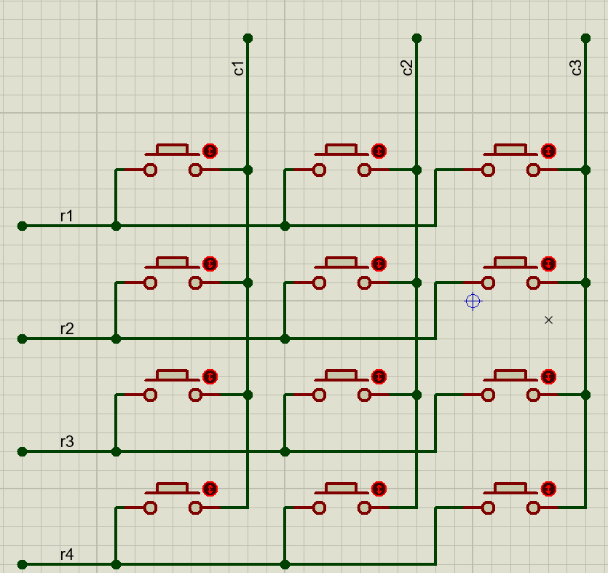
Internal working of Keypad matrix

Slide 3
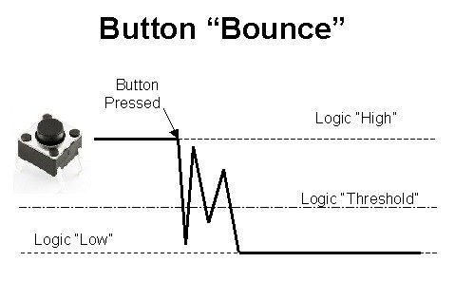
What is key debouncing?

Slide 4
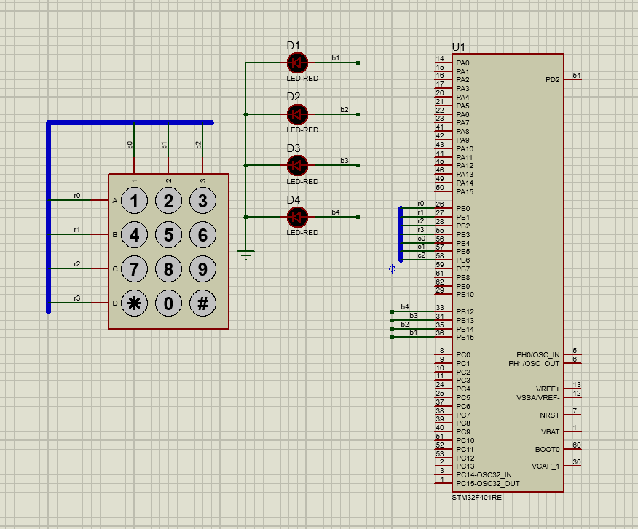
Schematic for further steps:

Slide 5
Steps for programming STM32
Enable clock for necessary ports.
Reset the GPIO’s that are to be used.
Configure the GPIO’s for input/ output.
Reset the PUPDR register for necessary pins.
Configure the necessary pins for PULL UP/ PULL DOWN with PUPDR.
Monitor the key pressed using Keyscan() driver function
Represent the pressed number in binary format using 4 led’s

Slide 6
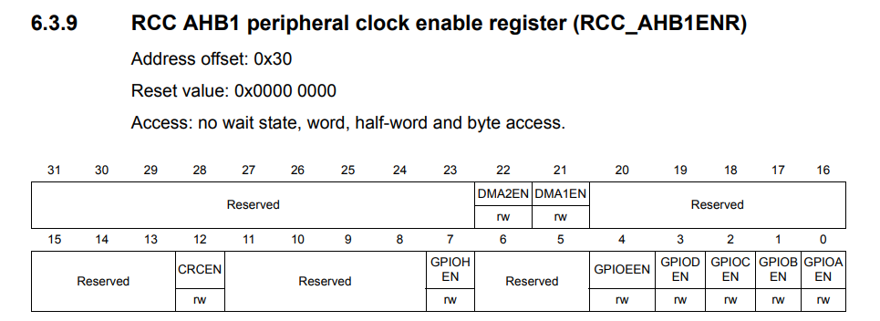
Enabling Clock
RCC->AHB1ENR = 0X00000002;
Let us use GPIOB for all the operations.

Slide 7
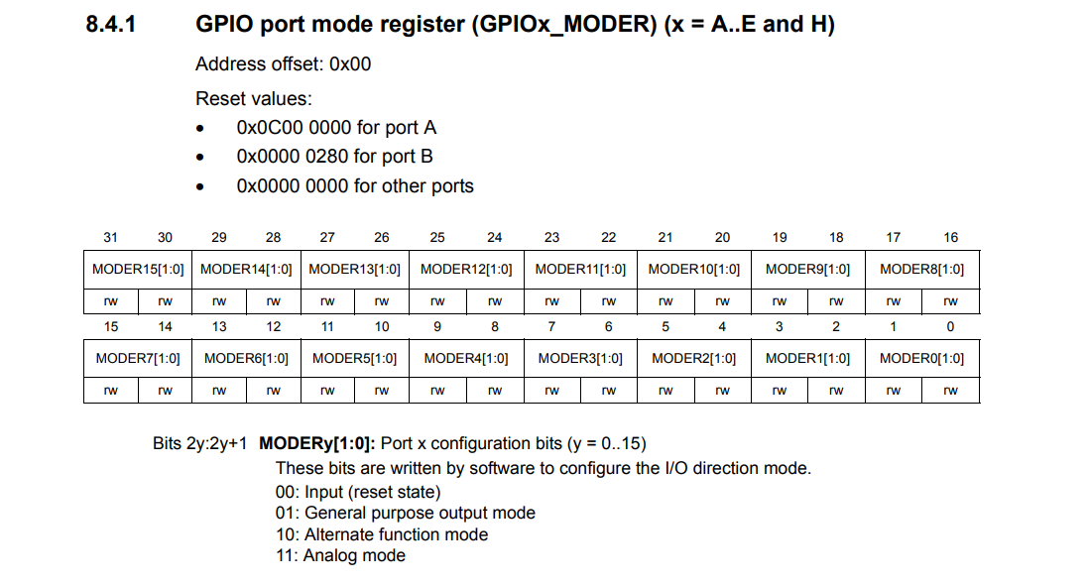

Slide 8
How to Write a value into a register?
GPIOA->MODER = 0X00000001; //which means PA.0 is output
Now if I want PA.3 to be as output then
GPIOA->MODER = 0X00000040;
This will configure PA.3 as output but remove the previous configuration of PA.0.
Instead we can use “&=~” combination read as “and assigned with negation of” to reset particular bits.
We can use “|=“ combination read as “or assigned with” to set particular bits.

Slide 9
How to Write a value into a register?
Objective: make PB.0 to PB.3, PB.12 to PB.15 as outputs and PB.4 to PB.6 as inputs
Steps:
Reset the MODER register of port B pertaining to PB.0 to PB.6 and PB.12 to PB.15
A moder state of “00” for a particular pin is assumed to be the reset state.
GPIOB->MODER&=~(0xFF003FFF);
Configure the MODER register of port B for PB.0 to PB.3, PB.12 to PB.15 as outputs and PB.4 to PB.6 as inputs
“01” for a pin is treated as output.
“00” for a pin is treated as input.
GPIOB->MODER|=(0x55000055);

Slide 10
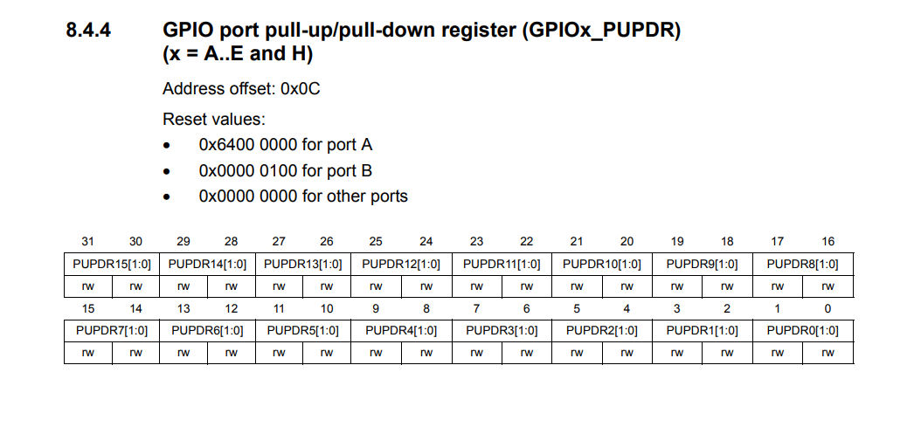

Slide 11
Configuring pull up and pull down registers
Why should I configure PUPDR?
When I don’t press the switch, the default value of the switch is depended on whether the pin is pulled up or pulled down.
What are the default values?
Pulled up pin: Default value is “0”.
Pulled down pin: Default value is “1”.
“00” is for No pull up No pull down
“01” is for Pull-Up
“10” is for Pull-Down
“11” is Reserved
Reset PUPDR
GPIOB->PUPDR&=~(0X00003F00);
Configure PUPDR
GPIOB->PUPDR|=0X00001500;

Slide 12
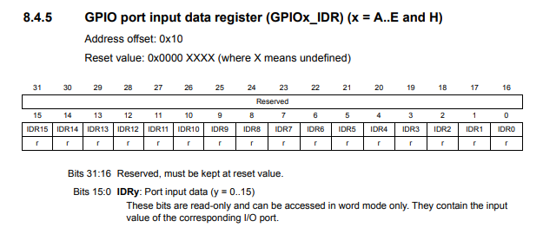
Monitoring IDR

Slide 13
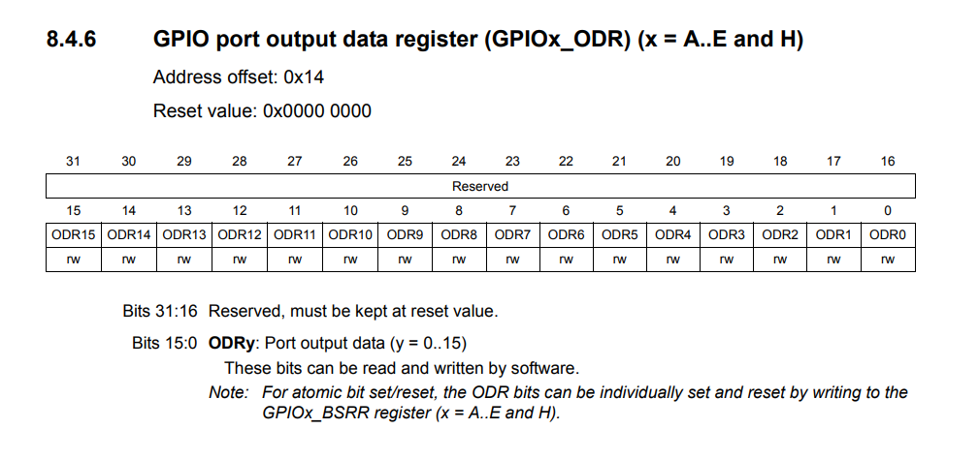
Configuring ODR

Slide 14
Keyscan() algorithm development
Configure Rows as Outputs and Columns as Inputs
Make all the rows as “0”
Once a column pin becomes “0” make rows “0” one by one and monitor IDR to find the exact row responsible for column activation
Wait until any one of the column pins become “0”
Once the column pin is found, row which is made 0 and column which is reading 0, combination position must be identified
Return that particular number
GPIOB->ODR&=!0X000000F;
while((GPIOB->IDR&0X70)==0X70);
GPIOB->ODR|= 0X0E; GPIOB->ODR|= 0X0D;
GPIOB->ODR|= 0X0B; GPIOB->ODR|= 0X07;
Return x;
temp = GPIOB->IDR & 0X70;

Slide 15
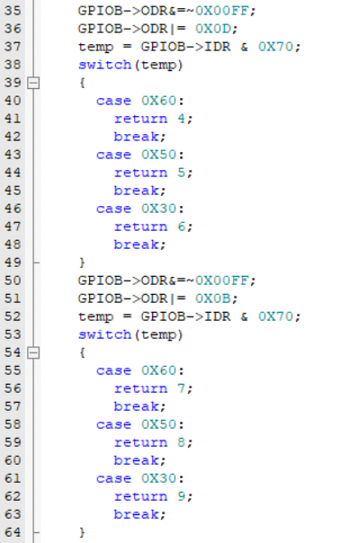
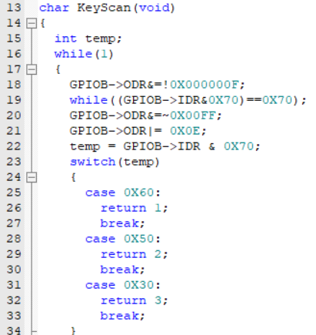
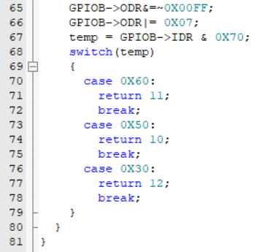
Keyscan() Logic

Slide 16
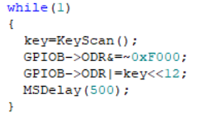
Writing the scanned key value onto check LED’s

Slide 17
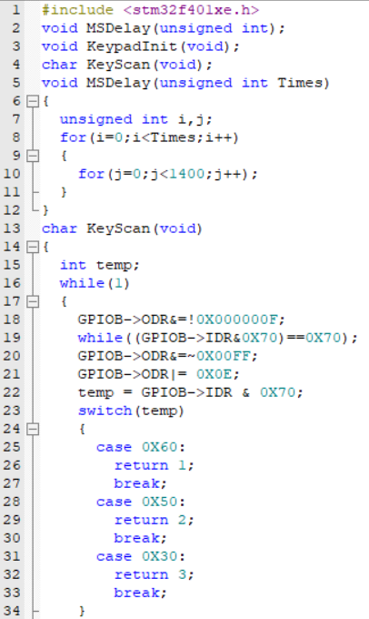
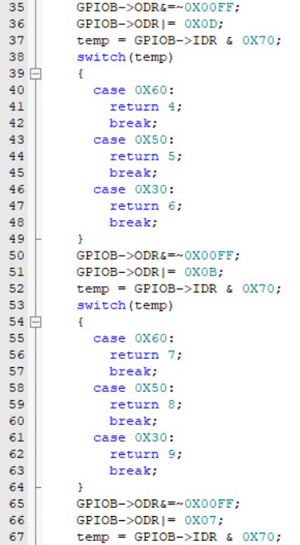
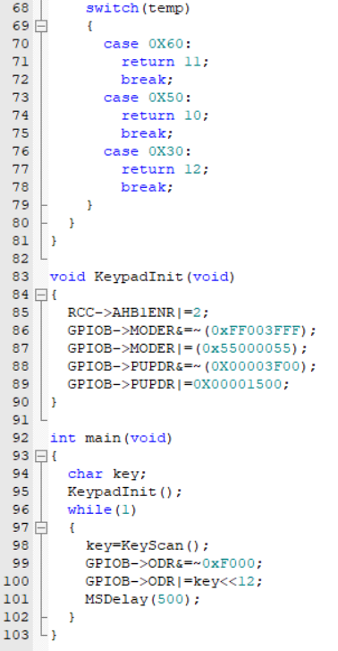
Final Code

Slide 18

Please Subscribe to my channel……..
Like Share Comment Subscribe

